Slide 1
WELCOME
NARMADA CONTROL AUTHORITY

Slide 2
Presentation
by
Mukesh Kumar Chauhan
Chief Engineer & Secretary
Narmada Control Authority

Slide 3
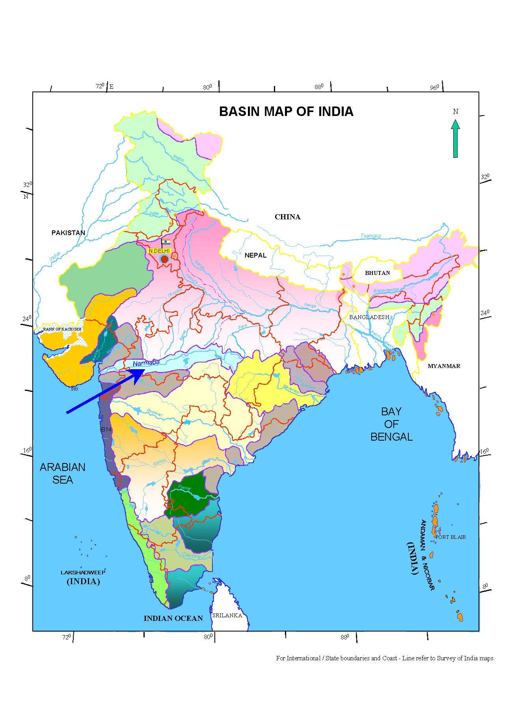
Narmada River
Fifth Largest River Of India
Largest West Flowing River
River Length - 1312 km
(from Amarkantak to Arabian Sea)
MP – 1077 km, MP & Mah - 35 km, Guj & Mah – 39 km, Guj – 161 km
Catchment Area – 98,796 km²
Mean Annual Rainfall - 1,180 mm
Average Annual Run-Off 41,000 MCM (33.21 MAF)
Narmada Basin

Slide 4
Narmada Control Authority (NCA)
Constituted in consequence to NWDT Award notified on 12th December 1979 for implementation of its orders.
NCA started functioning from 20th December 1980.
NWDT Award also ordered for setting up of
Sardar Sarovar Construction Advisory Committee (SSCAC)
Review committee for NCA (RCNCA)

Slide 5
NWDT had ordered
Fixing of Full Reservoir Level & Max Water Level of SSP and ISP. Full Supply Level of Sardar Sarovar Canal.
Regulated releases to be made by M.P. for Gujarat and Rajasthan and payment to be made by Gujarat to MP for such releases.
Sharing of Narmada Water between party states, cost of SSP, power of SSP, excess water and distress.
Provision for rehabilitation of Project Affected Families of SSP,
Acquisition of land and properties by Govt. of Madhya Pradesh and Maharashtra to be submerged under SSP .
Sharing of capital and revenue expenditure of Narmada Control Authority by the party States.

Slide 6
SHARE OF NARMADA WATER AND POWER OF SARDAR SAROVAR
EXCESS/DEFICT WATER TO BE SHARED IN THE SAME PROPORTION BY MP, GUJARAT, MAHARASHTRA & RAJASTHAN
WHENEVER WATER GOING WASTE, IT CAN BE UTILISED BY THE CONCERNED PARTY STATE WITH INTIMATION
TO NCA WHICH WILL NOT BE COUNTED AGAINST STATE’S SHARE

Slide 7
NCA COMPOSITION
CHAIRMAN - SECRETARY, GOVT. OF INDIA , M/O WATER RESOURCES
2-13 MEMBERS - SECRETARIES, GOVT. OF INDIA:
M/O ENVIRONMENT & FORESTS,
M/O SOCIAL JUSTICE & EMPOWERMENT AND
M/O TRIBAL AFFAIRS and M/O POWER.
CHIEF SECRETARIES:
MADHYA PRADESH, GUJARAT, MAHARASHTRA & RAJASTHAN
MANAGING DIRECTOR, SSNNL, GOG,
MEMBER (ENGG.), NVDA, GOMP
COMMISSIONER (CAD) & SECY.(IRRG.), GOM
C.E. & ADDL. SECY, IRRIGATION DEPT. GOR.
14-17 FULL TIME MEMBERS - EXECUTIVE MEMBER,
MEMBER (CIVIL), MEMBER (POWER) AND MEMBER (E&R)

Slide 8
REVIEW COMMITTEE
COMPOSITION
CHAIRMAN - UNION MINISTER (WATER RESOURCES)
MEMBER(S) - UNION MINISTER (ENVIRONMENT & FORESTS)
- CHIEF MINISTER (S) OF MADHYA PRADESH
GUJARAT, MAHARASHTRA & RAJASTHAN
CONVENOR - SECRETARY, MINISTRY OF WATER RESOURCES
FUNCTIONS
REVIEW OF DECISIONS OF NCA AND SSCAC
SUO-MOTO, ON APPLICATION BY STATE
IN URGENT CASES CHAIRMAN MAY STAY DECISIONS OF NCA/SSCAC ON REQUEST OF
A STATE OR
(b) SECRETARY (M/O E&F).

Slide 9
FUNCTIONS OF NCA
Coordination and direction of the implementation of all the projects including the engineering works, the environmental protection measures and the rehabilitation program of SSP
To ensure the faithful compliance of the terms & conditions stipulated by the Central Govt. at the time of clearance of the Indira Sagar &Sardar Sarovar projects.
The Authority shall be charged with the power and shall be under a duty to do any or all things for the implementation of the order of the Tribunal with respect to:
i) The storage, apportionment, regulation and control of the Narmada waters;
ii) Sharing of power benefits from Sardar Sarovar Project;
iii) Regulated releases by Madhya Pradesh;
iv) Acquisition by the concerned State for Sardar Sarovar Project of lands and properties likely to be
submerged under Sardar Sarovar;
v) Compensation , rehabilitation and settlement of oustees;
vi) Sharing of costs; and
vii) Environmental measures.
(4) To monitor the construction of Indira Sagar Project & Narmada Main Canal of SSP in Gujarat
& Rajasthan.
(5) To constitute one or more sub-committees and assign to them its functions and its power as it
think fits.

Slide 10
Narmada Basin Development
Integrated Water Resources Management.
1. Scientifically assessed and accounted utilizable flows in Narmada. Regeneration & evaporation considerd.
2. Clear cut guidelines for distribution of water.
Mechanism to prevent water going waste to sea as spillage during monsoon [Clause-IV (5
3 Development of Basin as a hydrological unit.
4. All States free to use their share of water in the manner they want.
5. Master plans by party States to utilize their share of water.
6 Project planning for multipurpose objective.
7. Cascade development of projects on the Narmada river.
8. Priority to drinking water.
9. Ensuring indented delivery to tail end State.
Optimum use of water, low delta, advance water application method, measures to reduce conveyances losses, anti soil salinity and anti-water logging measures,conjunctive use of water
11. Mechanism to redress institutional differences and monitor implementation of NWDT Award.
12. Inter-basin transfer to mitigate drought problems.
13. Advance Real Time Data Acquisition System RTDAS for Narmada basin.
14. Machinery to regulate operation of major reservoirs.

Slide 12
SALIENT FEATURES OF IMPORTANT PROJECTS IN NARMADA BASIN

Slide 13
SARDAR SAROVAR DAM
SHOWING IMPORATANT LEVELS
TOP OF DAM………………….…….. 146.50 m (480.6 ft)
MAXIMUM WATER LEVEL (MWL).. 140.20 m (460.0 ft)
FULL RESERVOIR LEVEL (FRL)…. 138.68 m (455.0 ft)
CREST LEVEL …………………….. 121.92 m (400.0 ft)
MINIMUM DRAW DOWN LEVEL…. 110.64 m (363.0 ft)
C/L OF 7.62 DIA RBPH 6 Nos PENSTOCK…97.50 m (319.8 ft)
DEAD STORAGE LEVEL…………… 93.57 M (307.0 ft)
4 Nos RIVER SLUICE LEVEL…………53 m (173.8 ft)
AVERAGE BED LEVEL……….18.00 m (59.0 ft)
RADIAL GATES - 23 Nos(18.3m x 16.76m.) For service Spillway
7 Nos. (18.30m. X 18.30) Auxiliary Spillway
Spillway Capacity - 84949.25 Cumecs (30 L Cusecs)
C/L OF 6.664 m CHPH PENSTOCK DIA…104.46 m ( 332.8 ft)
Canal FSL 91.45 m (300.0 ft)
Canal bottom Level 83.85 m (275.0 ft)
IBPT 5.5 m DIA ( 2 Nos.) – SILL LEVEL …87.92 m (288.38 ft)
NOTE
LIVE STORAGE AT FRL = 4.73 MAF
TANGENT POINT AT 89.22 m (292.64 ft)

Slide 14
CASCADE DEVELOPMENT IN LOWER NARMADA ZONE
INDIRA SAGAR PROJECT
FRL 262.13 M
MDDL 243.23 M
MAX TWL 230.00 M
FRL 196.60 M
OMKARESHWARPROJECT
MDDL 193.54 M
NORMAL TWL 196.15/196.06 M
MAX TWL 189.50 M (AT PMF)
MIN TWL 193.54 M
FRL 162.80 M
MIN TWL 162.20 M
EL. 179.80 M FOUNDATION LEVEL
MAHESHWAR PROJECT
EL. 160.60 M FOUNDATION LEVEL
SARDAR SAROVAR PROJECT
MAX TWL 142.90 M )
FRL 138.70 M
MIN TWL 140.50 M
EL. 139.50 M FOUNDATION LEVEL
FRL 110.60 M
MAX TWL 59.61 M
MIN TWL 25.91 M
SEA LEVEL
1312
1164
941
900
845
DISTANCE FROM SOURCE (km)

Slide 15
SALIENT FEATURES OF SARDAR SAROVAR PROJECT
(MULTIPURPOSE)
Location | Near Village Navagam Distt. Bharuch
Height (m) | 163.00
Length (m) | 1210.00
Gross Storage (BCUM/MAF) | 9.5(7.70)
Live Storage (BCUM/ MAF) | 5.8 (4.73)
Annual Irrigation (Lakh Ha.) | 17.92 in Gujarat, 2.46 in Rajasthan
Power Generation Installed Capacity (MW) | 1450 RBPH 6 x 200 MW CHPH 5 x 50 MW
Investment Clearance by the Planning Commission | Rs. 6406.06 crore at 1986-87 price level .Clearance in October, 1988.Narmada Canal in Rajasthan- Rs. 467.53 in 1989-90 price level. Clearance in 1996.
Initial Construction Schedule | Dam by January, 1998, Hydro Power by April, 1997, Main Canal up to Rajasthan border December, 1997. Complete Canal System with Command Area development -2004. Partial Irrigation and power generation planned by middle of 1995.
Revised Cost of Project (Rs in Crore) | 39240.45(2008-09 price level) 2481.49 (Rajasthan Canal) (2009 price level)
Expenditure Incurred up to November, 2014 (Rs. in Crore) | 44395.58 Crore
Cumulative Power Generated up to Dec., 2014 (in MU) | 34824.370 MUs
Status | Ongoing (EL 121.92)

Slide 16
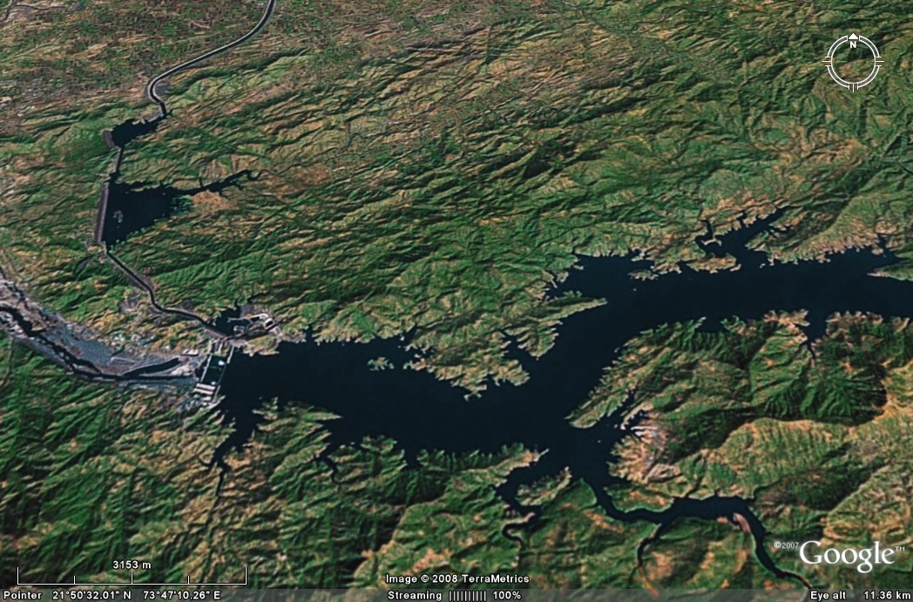
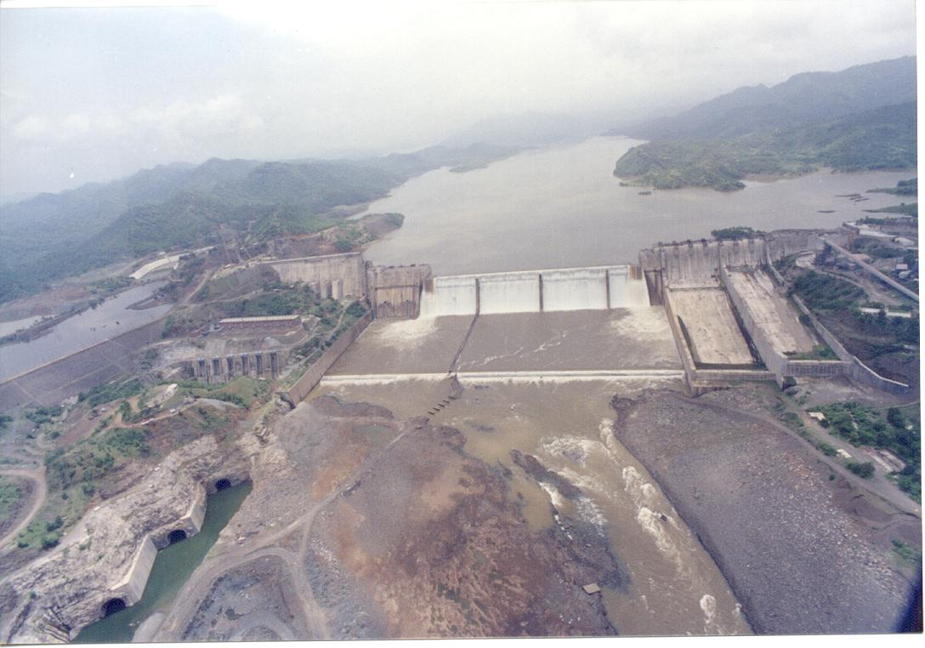
Sardar Sarovar Dam - Satellite View
HR of MAIN CANAL
Crest Level- 121.92 M
Dykes
GODBOLE GATE
Link Channels
Dykes
IRRIGATION BY PASS TUNNEL (IBPT)
CANAL HEAD POWER HOUSE (CHPH)
RIVER BED POWER
HOUSE (RBPH)
Reservoir at 121.92M
Sardar Sarovar Dam
PROPOSED GARUDESHWAR WIER
16

Slide 17
Overview of Dam & Hydropower Complex
VADGAM SADDLE DAM
CHPH
IBPT
Crest Level- 121.92 Mtrs
UG-RBPH
MAIN DAM
SWITCH YARD
POND-1
ROCKFILL DYKE-1
EXIT TUNNELS

Slide 18
Benefits from Sardar Sarovar Project
Gujarat |  |  | Rajasthan
 | Target | Achieved | Target | Achieved
Irrigation | 18.74 lakh | 187904 | 2.46 lakh | 1.5 lakh
Potential created | 17.92 lakh | 10.15 lakh | - | -
Drinking water supply | 173 UA 9490 villages | 157 UA 7789 villages | 3 UA 1336 villages | -
Population benefitted | 282 lakh | 252 lakh | 45.88 lakh | 0.70 lakh
Power generated (Cum) in 2013-14 | -- | 34824 MU 5877 MU | - | -
Annual Food Production | 8.7 MT

Slide 19
CUMULATIVE IRRIGATION POTENTIAL CREATED (up to minors) AND AREA IRRIGATED IN GUJARAT
Year | Cumulative IP created (up to Minors) (in Lakh Hectare) | Area Irrigated (in Hectare)
2005-06 | 3.12 | 57526
2006-07 | 3.94 | 61941
2007-08 | 4.60 | 69379
2008-09 | 4.81 | 83061
2009-10 | 4.95 | 121150
2010-11 | 5.24 | 167757
2011-12 | 5.45 | 193683
2012-13 | 6.73 | 209057
2013-14 | 9.48 | 187904
Up to Sept, 2014 | 10.038

Slide 20
COMMAND AREA OF SARDAR SAROVAR PROJECT
N
LUNI R
SUKRI R
BARMER
JALORE
NARMADA MAIN CANAL IN RAJASTHAN
PAKISTAN
BANSKANTHA
RANN OF KUCHCH
BANAS RIVER
RAJASTHAN
SABARMATI RIVER
MEHSANA
SABARKNTHA
G U J A R A T
BRANCH
LITTLE RANN OF KUCHCH
GANDHI NAGAR
KUTCH
WATRAK RIVER
MALIYA
MAHI RIVER
KUTCH
BR.
MADHYA PRADESH
DRANGADHRA
SAURASHTRA BR.
PANCHMAHAL
NARSINGPUR BR.
GULF OF KUCHCH
MORVI
BR.
A H M E D A B A D
BR.
MAHI RIVER
INDORE
SURENDRA NAGAR
KHEDA
DHAR
INDIRA SAGAR
JAMNAGAR
MAHESHWAR
VALLABHPUR BR.
VADODARA
OMKRESHWAR
RAJKOT
RIVER
RIVER
BOTAD BR.
BHADAR
LIMBDI BR.
NARMADA
SARDAR SAROVAR
KHANDWA
AMRELI
BHAVNAGAR
BHARUCH
KHARGONE
JUNAGADH
RIVER
TAPI
GULF OF KHAMBHAT
SURAT
MAHARASHTRA
LEGEND
INTERNATIONAL BOUNDARY
STATE BOUNDARY
NARMADA MAIN CANAL
COMMAND AREA (SSP)
MAHI COMMAND AREA
DANGS
ARABIAN SEA
VALSAD

Slide 21
DETAILS OF MAJOR IRRIGATION PROJECTS IN NARMADA BASIN

Slide 22
MAJOR PROJECTS
COMPLETED | ON-GOING | PROPOSED
MATIYARI | MAHESHWAR | UPPER NARMADA
RABLS (LBC) | SARDAR SAROVAR | UPPER BURHNER
BDP | LOWER GOI | HELON
BARNA |  | RAGHAVPUR
TAWA |  | SINGARPUR
KOLAR |  | UPPER BEDA
INDIRA SAGAR |  | BASANIA
SUKTA |  | ROSRA1
OMKARESHWAR |  | ATARIA
MAN |  | SHER
JOBAT |  | MACHREWA
 |  | SHAKKAR
 |  | SITAREWA
 |  | CHINKI
 |  | DHUDHI

Slide 23
PLANNED UTILIZATION OF NARMADA WATERS BY MADHYA PRADESH

Slide 24
YEARWISE UTILIZABLE FLOW & WATER UTILIZATION IN NARMADA BASIN

Slide 25
Water use in the year 2013-14
Allocated share by NWDT = MP - 22511 MCM- (18.25 MAF)
Gujarat - 11101 MCM (9.00 MAF)
Maharashtra - 308 MCM (0.25 MAF)
Rajasthan - 616 MCM (0.50 MAF)
Water use in the year 2013-14
States | Share in utilizable flow | Withdrawals
 |  | Irrigation | Domestic | Industries
Madhya Pradesh | 48,367 MCM (39.21 MAF) | 7654 MCM | 252 MCM | 14MCM
Gujarat | 23,852 MCM (19.34 MAF) | 4598 MCM | 1862 MCM | 59.92 MCM
Maharashtra | 662 MCM (0.54 MAF) | - | - | -
Rajasthan | 1325 MCM (1.07 MAF) | 513 MCM | 8 MCM | -
Grand total | 74206 MCM (60.16 MAF) | 12765 MCM (10.35 MAF) | 2122 MCM (1.72 MAF) | 73 MCM 0.06 MAF)

Slide 28
Inter Basin -Link completed/under Progess/Proposed
1. | Narmada Main Canal (Guj.-Raj.) | Length 458 km. CCA 18.4 lakh ha. CCA in Narmada Basin is @263210 ha. | 1. All Major rivers in Gujarat Narmada-Mahi-WATRAK- Sabarmati-Banas-Kutch and Saurashtra region 2.Also provides water to Rajasthan in Luni and Sukri River Basin (2.46 lakh ha.)-Jalore-Barmer.
2. | Bargi Diversion Scheme (Madhya Pradesh) | 194 Km. long Right bank Canal from Bargi Project Irrigate 2.45 lakh ha. | In Narmada Sone river basin Jabalpur, Katni, Satna, Rewa District .
3. | Narmada-Kshipra Narmada-Gambhir Narmada-Malwa Link | The NVDA has proposed to Lift 3 MAF of Narmada water to be used in Malwa region. | Narmada will be linked to Kalisindh, Parbati , Kshipra, Gambhir and surplus water of river Narmada will be linked.
4. | Narmada-Tapi Link | The Govt. of Maharashtra is considering joining river Narmada with River Tapi in Maharashtra. | In proposed stage 0.25 MAF allotted to Maharashtra has not been used so far.

Slide 29
MAJOR TRIBUTARIES
Kharmer Burhner* Banjar* Silgi
Temur Gour Hiran* Soner
Sher* Shakkar* Dhudhi Tendoni*
Sindhore Barna* Tawa* Kolar*
Ganjal* Sip Jamner* Datuni
Machak Chhota Tawa
Khari Kaveri Kanhar Choral*
Kundi* Karam Deb Man*
Goi* Uri* Hatni* Udai*
up to ISP
Between ISP and SSP
* Gauging sites available

Slide 30
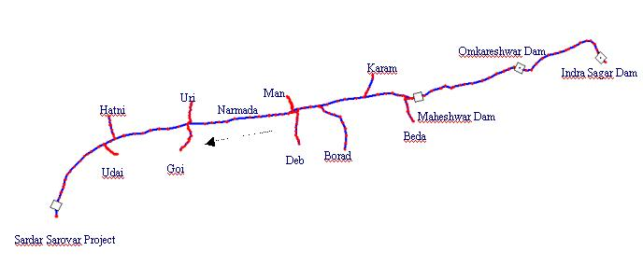

Slide 31
TRAVEL TIME IN DIFFERENT REACHES OF RIVER NARMADA
DINDORI 97Km
198 km
198 km
10-15 HRS UP TO MANDLA*
MANDLA 295Km
79 km
5-8 HRS UP TO BARGI
BARGI 374 km
152 km
115 km @16 Hrs
74-80 HRS UP TO SSP
BURMAN GHAT 526Km
150 km
172 km @22 Hrs
6-8 HRS TO H`BAD
TAWA
HOSHANGABAD 676Km
169 km
ISP 845 km
12-15 HRS TAWA UP TO ISP
51 km
OSP 894 Km
46 km
@6 Hrs
MAHESHWAR 940 km
114 km
@6-9 Hrs
BARWANI 1054Km
110 km
4-1 HRS
SARDAR SAROVAR 1164 km
11 km
GARUDESHWAR 1175 KM
* Travel time is less during monsoon season & more during non-monsoon season

Slide 32
Reservoir Positioning in Narmada Basin

Slide 33
SARDAR SAROVAR RESERVOIR REGULATION COMMITTEE (SSRRC)
Ex-Maheshwar releases and likely inflow/water level in the SSP
8.12 MAF (10016 MCM) ANNUAL
0.677 MAF (834.64 MCM) MONTHLY
Preparation of working table for operation of SSP and its review (Monsoon & Non-monsoon)
Irrigation and other requirements of GoG and GoR
Requirement of operation of IBPT, if any, to meet the requirement of irrigation of GoG/GoR and assessment of likely loss of power due to running of IBPT
Requirement of water use downstream of the Sardar Sarovar Project
Annual Water Accounting & Assessment of Utilizable Flow
Likely generation of power through CHPH and RBPH during the month
Power generation loss due to running of IBPT

Slide 34
Major Stipulations in NWDT Award to be considered in
Integrated Water Resources Management
1. 75% dependability utilizable flow - 28 MAF
2. Allocations of Narmada Water
Madhya Pradesh - 18.25 MAF
Gujarat - 9 MAF
Maharashtra - 0.25 MAF
Rajasthan - 0.50 MAF
3. Allocation is related to actual withdrawals and not consumptive use.
4. Water year 1st July to 30th June
5. Excess or Deficit of 28 MAF to be shared in ratio of allocation
6. Available water includes the Return flows and exclusive of the evaporation loss
Utilisable flow = Observed flow + Upstream use
+Carryover Storage = +Change in storage
7. Uniform monthly regulated releases of 834.65 M.cum (0.677 MAF) by Madhya Pradesh for meeting requirements at Sardar Sarovar (When there is 28 MAF flow).
8. The releases from GoMP to be made in such a way that there is all the time sufficient water is available in Sardar Sarovar to meet the requirements of the 10 day period subject to water being available in the storages of M.P. after taking M.P.’s share.
9. Environmental flow of 600 cusecs.

Slide 35
TYPICAL RELEASE PATTERN OF EX MP (OSP)

Slide 36
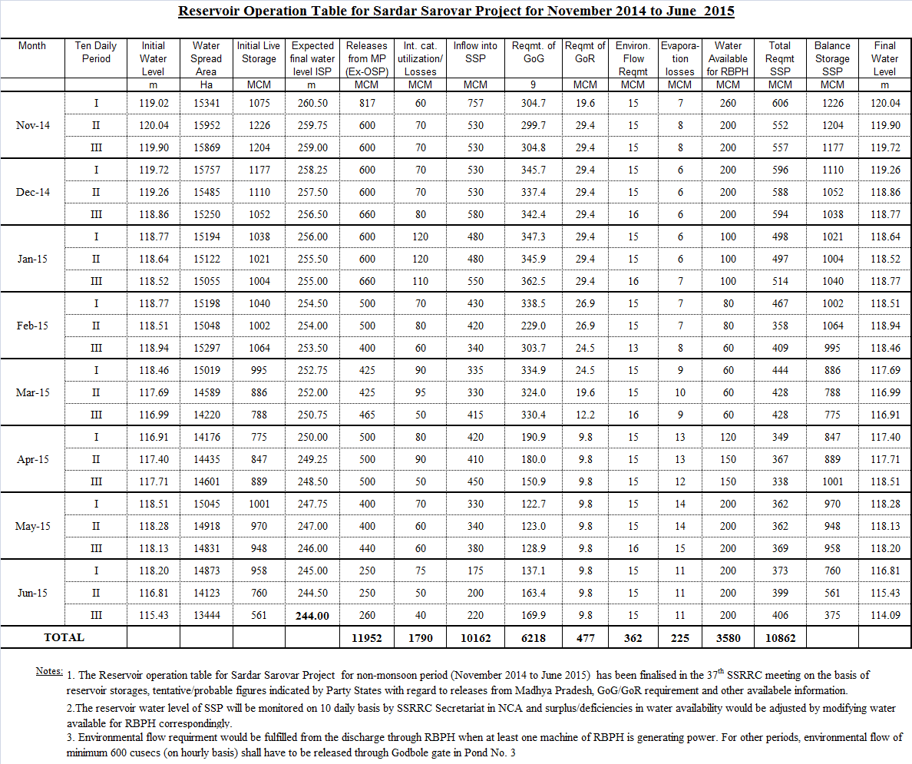

Slide 37
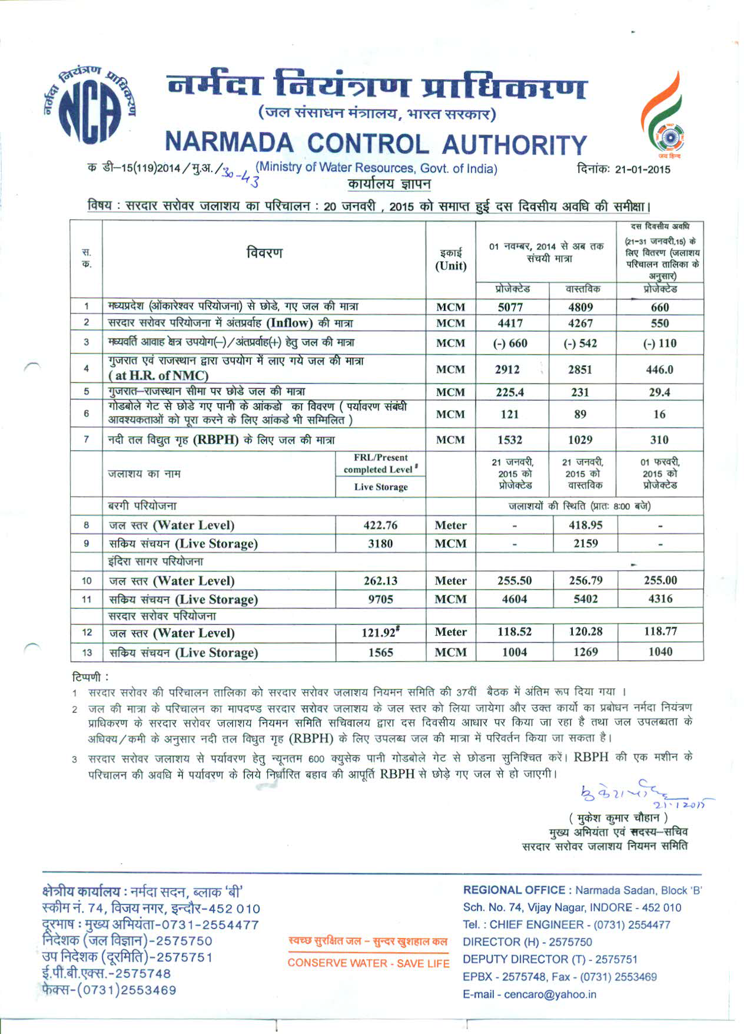

Slide 39
DEMAND & SUPPILES MADE THROUGH RESERVOIR OPERATION OF SSP

Slide 40
Irrigation Practices in Gujarat
Most intensively investigated project in the country, detailed soil studies, including Topographical, Geo-Hydrological and soil surveys have been carried out.
Careful zoning of command area from consideration of subsurface and surface drainage has been done.
SSP command area classified into 13Agro climate zone. Subareas likely to be affected by waterlogging/soil salinity identified.
Remedial, anti waterlogging and anti salinity measures have been taken. All the canals up to 8 ha. Blocks lined.
Low water allowance delta at main canal head of 53 cm. over the command area
Better water management and participation of farmers. The discharge from the canals down to 8.5 cumec (300 cusecs) will be regulated through automatic computer control.

Slide 41
Irrigation Practices in M.P.
The area not covered by gravity are being provided irrigation through Lift irrigation from the canal.
The farmers along Narmada river are having private pumps for irrigation and raising good cash crops.
Better water management practices in the command of Indira Sagar, Omkareshwar Canals.

Slide 42
Rajasthan - Advance Irrigation practices
Water Allocated - 0.5 MAF - At border = 0.484 MAF
Initial Planning - 70 thousand ha. = 596 MCM
(Average delta= 0.85 m.)
Revised planning - 2.46 lakh ha. (Average delta=0.24 m.)
Advance water management practices
Application of irrigation water by sprinkler or drip mandatory (Pressure irrigation) Water from minors will be drawn into diggies (shallow tanks) from where cultivators will draw their share of water by using pumps
Operation and maintenance of the system will rest with the water users Association (2252 numbers)
Capacity of diggies to store water upto 4 hours. The sprinklers at the farmer’s field will get water through an underground buried pipe network consisting of mains and sub-main pipes. Power requirement (0.15 Km. per ha.)

Slide 43
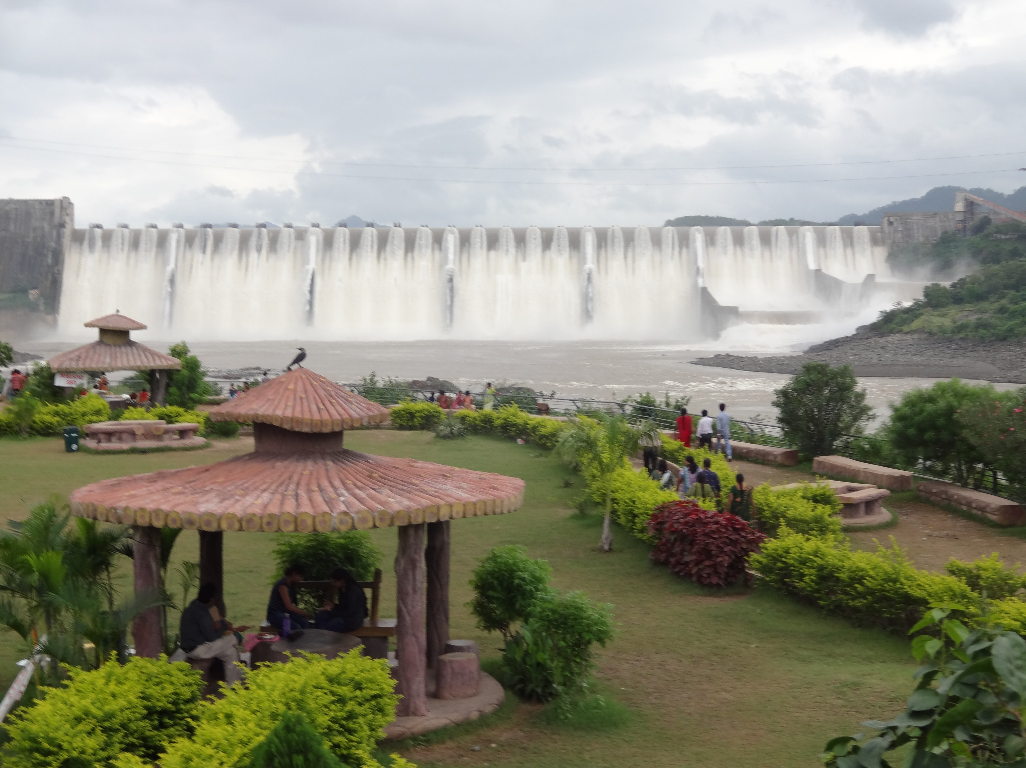
Thank you
SARDAR SAROVAR DAM DURING MONSOON - 2010
43

Slide 44
NCA - SUB-GROUPS/SUB-COMMITTEES
Environment Sub-group
Chairman : Secretary, Government of India, Ministry of Env. & Forests
Environment Committee
Chairman : Member [E&R], Narmada Control Authority
High Level Expert Group on Fisheries Development and Conservation in SSP
Chairman:Jt. Secretary(F), Government of India, Ministry of Agriculture.
Resettlement & Rehabilitation Sub-group
Chairman: Secretary, Government of India, Ministry of Social Justice & Empowerment.
Task Force on R&R for SSP.
Committee for consultations with Grievances Redressal Authority (GRA) for MP, Gujarat and Maharashtra headed by Executive Member NCA
Narmada Main Canal Sub-Committee
Chairman: Executive Member, Narmada Control Authority
Hydromet Sub-group
Chairman: Executive Member, Narmada Control Authority
Sardar Sarovar Reservoir Regulation Committee
Chairman: Exacutive Member, Narmada Control Authority.
Power Sub-Committee
Chairman: Member [Power], Narmada Control Authority

Slide 45
Hon’ble Supreme Court Judgment on SSP dated 18-10-2000, for further raising beyond 90M
The operative part of Judgment is as follows:
1. Construction of the dam will continue as per the Award of the Tribunal.
2. The Relief & Rehabilitation Sub-Group cleared the construction up to 90 metres, the same can be undertaken immediately. Further, raising of the dam height on pari-passu implementation of the R&R and on the clearance by the R&R Sub-Group after consulting the three Grievances Redressal Authorities ( GRA).
3. The Environment Sub-group under the Secretary, Ministry of Environment & Forests, Government of India will consider and give, at each stage of the construction of the dam, Environment clearance before further construction beyond 90 metres can be undertaken.
4. The permission to raise the Dam height beyond 90 meters will be given by the NCA, from time to time, after it obtains the above clearances from the R&R Sub-Group and the Environment Sub-Group.”
5. Every Endeavour shall be made to see that the project is completed as expeditiously as possible.

Slide 46
STATUS OF REHABILITATION OF SSP UPTO FRL (138.68m) (As on 31.12.2014)
State | Total PAFs | PAFs resettled so far in |  |  | Total PAFs Resettled | Balance
 |  | Gujarat | Maharashtra | M.P.
Gujarat | 4765 | 4765 | 0 | 0 | 4765 | 0
Maharashtra | 4300 | 748 | 3237 | 0 | 3985 | 315*
Madhya Pradesh | 37757 | 5536 | 0 | 32221 | 37757 | 0
Total | 46822* | 11049 | 3237 | 32221 | 46507 | 315*
* This number may change after reconciliation of genuine PAPs, as on date.

Slide 47
Progress made on Resettlement & Rehabilitation of Project Affected Families up to December, 2014
STATE | Total Project Affected Families | Total PAFs Resettled | Balance Families to be resettled
GUJARAT Total (i) | 4765 | 4765 | 0
MAHARASHTRA In Gujarat In Maharashtra Total (ii) | 748 3552 | 748 3237 | 0 315
 | 4300 | 3985 | 315
MADHYA PRADESH In Gujarat b) In Madhya Pradesh Total (iii) TOTAL (i)+(ii)+(iii) | 5536 32221 | 5536 32221 | 0 0
 | 37757 | 37757 | 0
 | 46822* | 46507 | 315*
* The number may change after inclusion of PAFs to be declared by Grievance Redressal Authorities (GRAs)/State Government including impact of back water level

Slide 48
ORGANISATION CHART OF NCA GROUP - A OFFICERS AS ON 12th JANUARY, 2015
Chairman
A.K. Bishnoi
Executive Member
A.Mahendran*
P P S
K.Venugopal
Member (E&R) Dr. Afroz Ahmed
Member (P)
M.A.K.P.Singh
Member (Civil)
Lalit Kumar*
Chief Engineer (RO)
M.K. Chauhan
Secretary
M.K.Chauhan*
Director (IA&R)
S R Yadav DD (I/C)
Director (Env.)
Pawan Kumar
S.E (EMC)
vacant
Liaison Office
New Delhi
Director (H)
(Vacant)
S.E (C) Bhopal
D.Ilanchezhiyan
D D (I/C)
Director (C)
Vadodara
Naresh Lall
Director (C)
vacant
D.D
S.R. Yadav
D.D
vacant
D.D
Usha Dwivedi
EE (EMC)
H. Pandey
F.O
R .Vasudevan
D.D (Buld)
D.Ilanchezhiyan*
D.D (Tel.)
V.D.Gupta*
D.D (HM)
D.Ilanchezhiyan
D.D(H)
R vasudevan
D.D (Adm.)
Viinod Dialani
D.D.(TC)
A.D.Jain
AD (E)
R.Sharma
AD (L)
R.S. Bobade*
A.D (Civil)
Vijai Choudhary
AD (Civil)
R. Parmar*
AD (L)
R. Mishra*
R.Thakkar
A.P.R.O
*Additional Charge

Slide 50
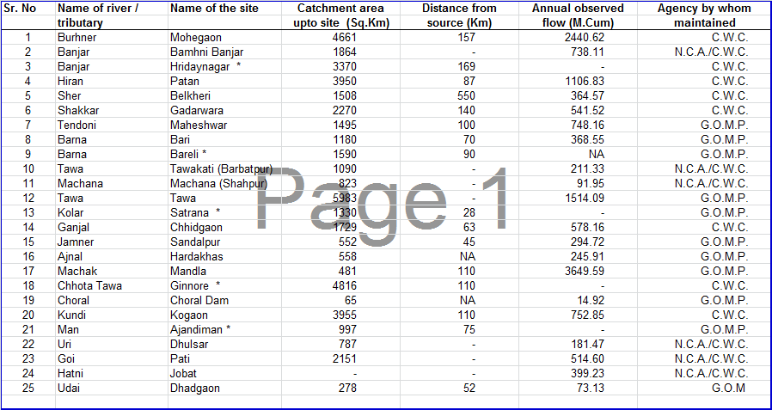

Slide 51
ISSUES BEFORE RCNCA
Compensation for power loss due to running of Irrigation Bye-Pass Tunnel [IBPT] at SSP.
Sharing of cost of R&R of SSP.
Sharing of cost of Catchment Area Treatment.
ISSUES BEFORE NCA
Compensation of forest land going under submergence.
Permanent approval of NCA for permitting GoG for operation & testing of IBPT gates during overflow of SSP.
Decisions/Resolutions passed in the NCA meetings which amount to modify the provisions of the NWDT Award.
Sharing of NCA Office expenses regarding Power (EMC) component.

Slide 52
CONSTRUCTION OF SARDAR SARDAR SAROVAR DAM
BEYOND 90 M
NCA accorded approval for raising dam height upto 121.92 M, time to time after obtaining necessary clearances from its Environment and R&R Sub-Group
FINAL RAISING OF SARDAR SARDAR SAROVAR DAM BEYOND 121.92M
(Stages of construction approved by NCA during 80th meeting)
Stage 1 : Spillway piers, bridge to full height and installation of gates (to be kept in raised position) ( Programme of works to take 36 months after approval from NCA)-Permission granted for Stage-I during 86th (emergency) meeting held on 12th June, 2014.
Stage 2: Gates lowering – Water impoundment up to FRL (EL. 138.68m)

Slide 53
Status of Canals under Sardar Sarovar Project
Particulars | Unit | Total Qty. | Progress achieved up to Nov, 2014
Main Canal | Km. | 458.32 | 458.32
Branch Canal | Km. | 2585 | 2354.87
Distributaries | Km. | 5112 | 3310.77
Minors | Km. | 18413 | 9342.86
Sub-Minors | Km. | 48058 | 10250.59

Slide 54
M.P. Water Use Plan
S.No. | Category | Numbers | Water use
1. | Major Projects | 29 | 14012 (11.38 MAF)
2. | Medium Projects | 135 | 3551 MCM (2.88 MAF)
3. | Minor Projects | 3000 | 3094 MCM (2.51 MAF)
4. | Municipal use (42 towns) |  | 933 MCM (757 MAF)
5. | Industrial use |  | 916 MCM (0.743 MAF)

